Slide 1
Correctional Continuum
Prisons 101

Slide 2
Prison Basics
Classification
Minimum
Medium
Hybrid “high-close”
Max
Super-Max
Additional administrative facilities
Medical, classification, etc.

Slide 3
Prisons in the U.S. Roughly 1.5 million inmates held in…
Minimum Security | 969
Medium Security | 480
Maximum Security | 372
Fewer than 500 inmates | 946
501-999 Inmates | 304
1,000-2,499 Inmates | 495
2,500 inmates or more | 76

Slide 4
Federal
Federal Bureau of Prisons (BOP)
200,000 + inmates across roughly 100 prisons
Differences with state systems
Type of inmates (federal crimes?)
Change in 1980s
Management/innovation/better image

Slide 5
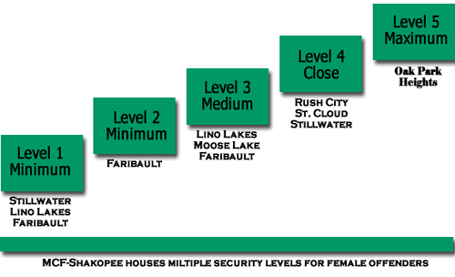
MN Prison System
http://www.doc.state.mn.us/facilities/default.htm

Slide 6
Super-Max Prison
Old idea (Alcatraz opened in 1932)
First federal super-max
Now, Florence, CO as “Alcatraz of the Rockies”
State building spree starts in late 1980s
Developed from expanding “administrative segregation units”
Still lots of variation as what “counts”
44 States now have some form of S.M. prison

Slide 7
Super-Max II
Common theme
23 hours per day in cell, minimum contact with “outside,” highly regimented/restricted
Research Areas
Who is incarcerated there?
Classification as “administrative” decision
What effect does incarceration have on inmates?
What effect does having a S.M. have on other prisons?

Slide 8
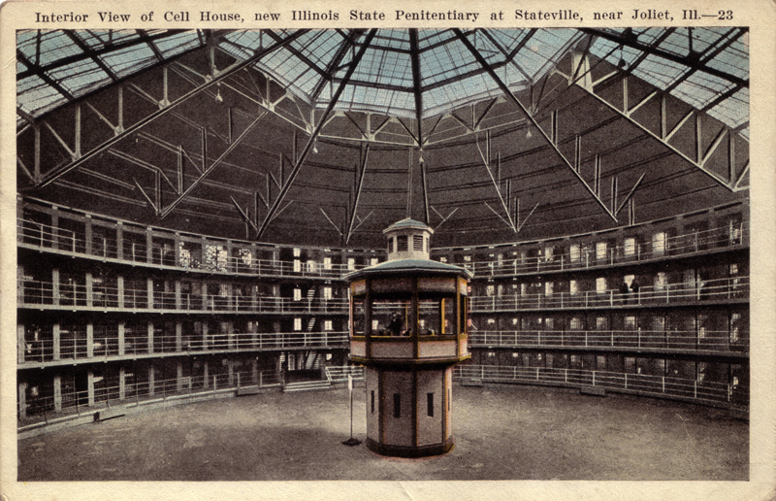
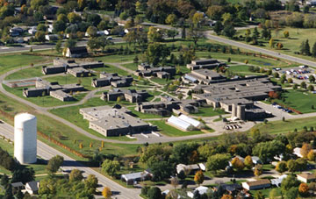
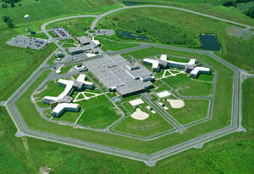
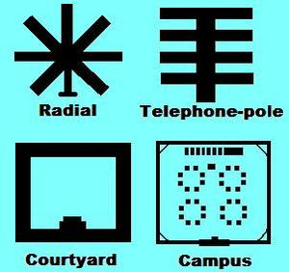
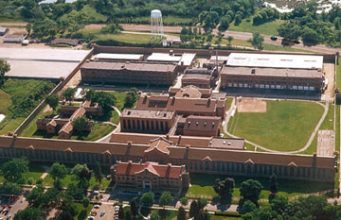
Prison Architecture

Slide 9
Inmate Classification
Historically
Women and Children (1850s)
“psychiatric” where used at all (1930s)
classification officer → recommend security level for each inmate (1960s)
inmates to “least restrictive” housing, inmate needs must be assessed regularly (1970s)
Current models
External: what prison? → risk, violence, etc.
Internal: which cell-mate, unit, etc. → personality types (Quay)
Greater trend toward “actuarial” assessment with “dynamic” factors

Slide 10
Pains of Imprisonment
Gresham Sykes (1958)
Inmates are Deprived of…
physical safety
heterosexual relations
autonomy
material goods
freedom

Slide 11
Inmate Culture
Donald Clemmer (1940)
A unique system of beliefs, language, economy
Coined term “prisonization”
Inmates who are socialized to the prison culture
Inmate code
Do your own time
Don’t rat/snitch
Don’t associate with the guards/administrators
Be tough, be a “man,” and don’t “whine”
Don’t exploit other inmates (“Don’t steal from cons…”)

Slide 12
Aspects of Culture
Inmate code
Inmate economy
Inmate argot (language)
Will see economy, argot, code and whatnot in NM riot movie
Research
Is prisonizaiton a good or bad thing? Can inmates “shed” culture when they leave prison?
What causes inmate culuture?
Importation models
Deprivation models (Sykes’ “pains”)
Limitation: research done in older, Max facilities (“big house”)

Slide 13
Prison Crime
Violence
Inmate → inmate or staff
Staff → inmate
Sexual Assault
Crucial issue is how to figure out the level of crime
Incident reports or other “official” data?
Inmate self-report
Inmate victimization surveys
Property crime
Prison Riots
“incidents”

Slide 14
Prison Industry
Rationale
Profit
Punishment
Vocation/Rehabilitation
Prison Management

Slide 15
Types of Prison Industry
Old Versions
Contract system
Lease System
Corruption/scandal, other protests against industry led to legislative interventions
State-use
Rebirth in 1970s (PIE Act)
Corporate Model
Private/public partnerships
Free enterprise

Slide 16
MNCORR
Division of MN DOC
Self-sufficient
Produce own goods
Docks/piers, office equiptment….
Contract with private firms
Balloons
MN residents, government, non-profits can purchase MNCORR goods

